Slide 1
Virtualization Security Introduction
Chris Shenefiel

Slide 2
What we will cover…
Why do we care about Virtualization Security
Virtualization Introduction
MAC Introduction
Background of LXC, KVM/QEMU and Xen
Compare the two predominant Open Source Virtualization technologies (Xen and KVM/QEMU)
Overview security models and mitigation for each
VMM Integrity Measurement

Slide 3
Virtualization Security - Why
Cloud computing depends on sharing hardware across many users
Diverse cloud customers don’t necessarily want their information shared with others
Many customers on one hardware platform becomes a rich target for attacks
Virtualization is a relatively new technology with immature security models

Slide 4
Known Vulnerabilities (source: NIST NVD)
Notes:
Mention the context for each of the Virtualization environments

Slide 5
Virtualization Categories
Virtual Machine Models
Type 1
Type 2
Virtualization Approaches
Hardware virtualization
Para-virtualization
Containers

Slide 6
Virtual Machine Monitor (VMM) Models
Type 1 Hypervisor
Also referred to as bare metal hypervisors
Hypervisor runs as the first level of operating environment
Small footprint and designed explicitly as a Hypervisor and nothing more
Significantly smaller attack surface than Type 2
Examples: Xen, ESXi, Hyper-V
Type 2 Hypervisor
Runs as an application under another operating system
Larger footprint (Hypervisor software + interfaces to host operating system)
Large attack surface
Examples: VMware Workstation/Fusion, VirtualBox, KVM/QEMU

Slide 7
Hardware Virtualization
Software emulates hardware behavior
Software drivers handle all hardware interrupt behavior and pass to real hardware
CPU’s
Block IO
Serial IO
Key benefits
Makes virtualization hardware independent
Emulation for most common hardware improves guest OS support
Challenges
Slow

Slide 8
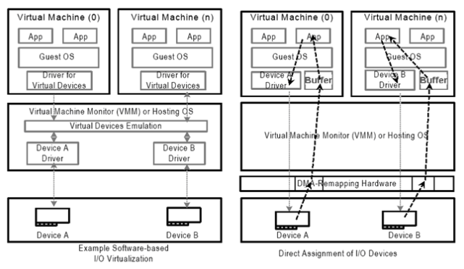
Para-virtualization and pass-through hardware
Software stub driver that translates hardware calls through hypervisor to hardware
Very low overhead and near native hardware performance particularly with CPU instruction set extensions
Intel’s VT-d achieves near native performance by passing through hardware interface and DMA to the guest

Slide 9
Intro: MAC significantly improves isolation
KVM/Qemu security policy and labels (dynamic or static)
KVM/Qemu
Standard Applications
Application
(Feature/Agent/Service)
LXC Container
Application
(Feature/Agent/Service)
Kernel/Libraries
Hardware Emulation
Container Svcs
Linux Kernel/Libraries
MAC enforced
Drivers
Container Security policy and labels
Hardware
= Mandatory Access Control (using SELinux, AppArmor, SMACK) to improve application, KVM, and LXC isolation.
Notes:
SMACK has been used to build a secure LXC container for NX-OS

Slide 10
How MAC works
user level process
User Space
open system call
Kernel Space
look-up inode
error checks
SELinux
Smack
AppArmor
DAC checks
LSM Policy Engine
LSM hook
OK with you?
Check against policy
complete request
Program load, File System,
IPC, Network, Kernel Module

Slide 11
About LXC
Libvirt
LXC
Initial release on 8/6/2008
Current stable release 1.0.5 (7/14/2014)
Leverage host kernel features and utilities to isolate process space and file systems
Security model improving with each new release
Benefits:
very lightweight (low CPU/Memory/Disk)
inherit the guest OS kernel so easy to patch containers
integrated management with libvirt
App
App
App
App
App
App
Container
Container
Container
Host Linux Kernel
Drivers
Namespaces
cgroups
chroot
MAC
Hardware

Slide 12
LXC Attributes
Lightweight: Runs as a controlled space process sharing host kernel
No hardware emulation
No additional OS per container
Leverages advanced features of modern Linux Kernel
cgroup (control process resource utilization)
namespaces (control process permissions)
chroot (control process filesystem access and permissions)
MAC (Mandatory Access Control of process privileges)
Managed through libvirt library
Docker – improved management and deployment through container images and overlays
Isolation and security model limited but improving
New developments offer promise (unprivileged containers in LXC 1.0 – beta)
Namespace control for process access just recently included file systems (3.10 kernel)
Root on host can see and change all container processes and file systems

Slide 13
Example: LXC vs. KVM/QEMU Root Visibility
Host root user ps –xf for LXC container running minidlna
263378 ? Ss 0:00 init
263480 ? S 0:00 \_ upstart-udev-bridge --daemon
263482 ? Ss 0:00 \_ /sbin/udevd --daemon
263509 ? S 0:00 | \_ /sbin/udevd --daemon
263510 ? S 0:00 | \_ /sbin/udevd --daemon
263579 ? S 0:00 \_ upstart-socket-bridge --daemon
263613 ? S<s 0:00 \_ /bin/sh -e /proc/self/fd/9
263638 ? Ss 0:00 \_ /usr/sbin/sshd -D
263683 ? Ss 0:00 \_ /usr/sbin/xinetd -dontfork -pidfile /var/run/xinetd.pid -stayalive -inetd_compat -inetd_ipv6
263697 ? Ss 0:02 \_ cron
263796 ? Ss 0:00 \_ /usr/sbin/saslauthd -a pam -c -m /var/run/saslauthd -n 2
263797 ? S 0:00 | \_ /usr/sbin/saslauthd -a pam -c -m /var/run/saslauthd -n 2
263847 ? Ss 1:05 \_ sendmail: MTA: accepting connections
263904 ? Ss 1:43 \_ /usr/sbin/ntpd -p /var/run/ntpd.pid -g -u 108:112
263937 ? Ss 0:46 \_ /usr/sbin/apache2 -k start
263946 tty1 Ss+ 0:00 \_ /sbin/getty -8 38400 tty1
660316 ? Ssl 0:01 \_ /usr/sbin/minidlna -R -f /etc/minidlna.conf
Host root user ps –xf for QEMU KVM running Ubuntu and Zimbra
631718 ? Sl 172:05 /usr/bin/kvm

Slide 14
LXC Security Considerations
Use LXC in ways it was intended
Ubuntu documentation paraphrase: … the goal of 12.0.4 LTS security for LXC is not to prevent malicious actions but rather to stop accidental harm of the host by the guest…”
Containers that need escalated privilege increase the attack surface
Network interfaces
Multicast, broadcast, packet sniffing
Accessing raw devices
Mounting file systems
Containers will always share the same kernel as the host
If sycall is buggy (e.g., vmsplice…) and lets you execute arbitrary code, game over.

Slide 15
LXC Mitigation best practices
Privilege Escalation
Employ MAC to improve isolation within and between containers
Remove SUID binaries where possible (or mount with nosuid)
Use GRSEC (ASLR, non-executable stack, refcount overflows, erase pages, etc.)
Reduce attack surface
Consider using seccomp (LXC support evolving) to sandbox LXC container from subsets of system calls
Denial of Service
Restrict resource utilization by tuning cgroups parameters (memory, processor, network)

Slide 16
KVM/QEMU Attributes
KVM hypervisor support within the Linux OS
Virtual Machines run as a process with special privileges and managed by libvirt
KVM offers kernel-based hardware acceleration to virtualization engines (QEMU)
Good for drivers and rapid development but hypervisor is a full operating system (large attack surface)
Libvirt
VM Runtime
App
App
Guest Kernel
I/O Devices
vCPU Runtime
Virtual Hardware
Host Linux Kernel
I/O Stack
Hardware (VT-x, AMD-V)

Slide 17
About KVM
KVM = Kernel-based Virtual Machine
Added to Linux mainline starting with 2.6.20 (early 2007)
Development project led by Avi Kivity and partially funded by startup Qumranet in Israel
Qumranet created a commercial SolidICE (based on open source KVM)
SolidICE included patented protocol SPICE: Similar to RDP but optimized for bi-directional multimedia streams and workload balancing
Red Hat bought Qumranet in 2008 and added KVM and SPICE to RHEL 5.4
KVM is integrated into the mainline so new Linux distributions include updates and drivers

Slide 18
KVM/QEMU Threats
Privilege Escalation – exploit that allows code in an unprivileged VM to execute code in a privileged space
VM Escape – compromise the hypervisor and assume controls over VM’s
Denial of Service – system crash or access to resources denied

Slide 19
KVM/QEMU: Mitigate Privilege Escalation
Privilege Escalation would give unprivileged processes in the guest necessary privileges to run in a privileged environment (e.g., host)
Migitation
Use MAC to force virtual machines to run under a confined domain
Protects guest from gaining access to host but does not protect from attacking other guests

Slide 20
KVM/QEMU: Mitigate VM Escape
VM Escape would compromise the hypervisor and gain control of other VM’s
Includes guestfish access to hypervisor image files
Migitation
SELinux and sVirt confinement
Each QEMU machine runs under its own confined domain based on category numbers that are statically or dynamically assigned

Slide 21
KVM/QEMU: Mitigate Denial of Service
Block device I/O
QEMU blk-throttle
QEMU caps through block limited
CGROUP blkio
Network
libvirt KVM
tc
Virtual Switches (N1000v, Open vSwitch)
EXAMPLE: Libvirt KVM XML to control network bandwidth
<devices>
<interface type='network'>
<source network='default'/>
<target dev='vnet0'/>
<bandwidth>
<inbound average='1000' peak='5000' floor='200' burst='1024'/>
<outbound average='128' peak='256' burst='256'/>
</bandwidth>
</interface>
<devices>

Slide 22
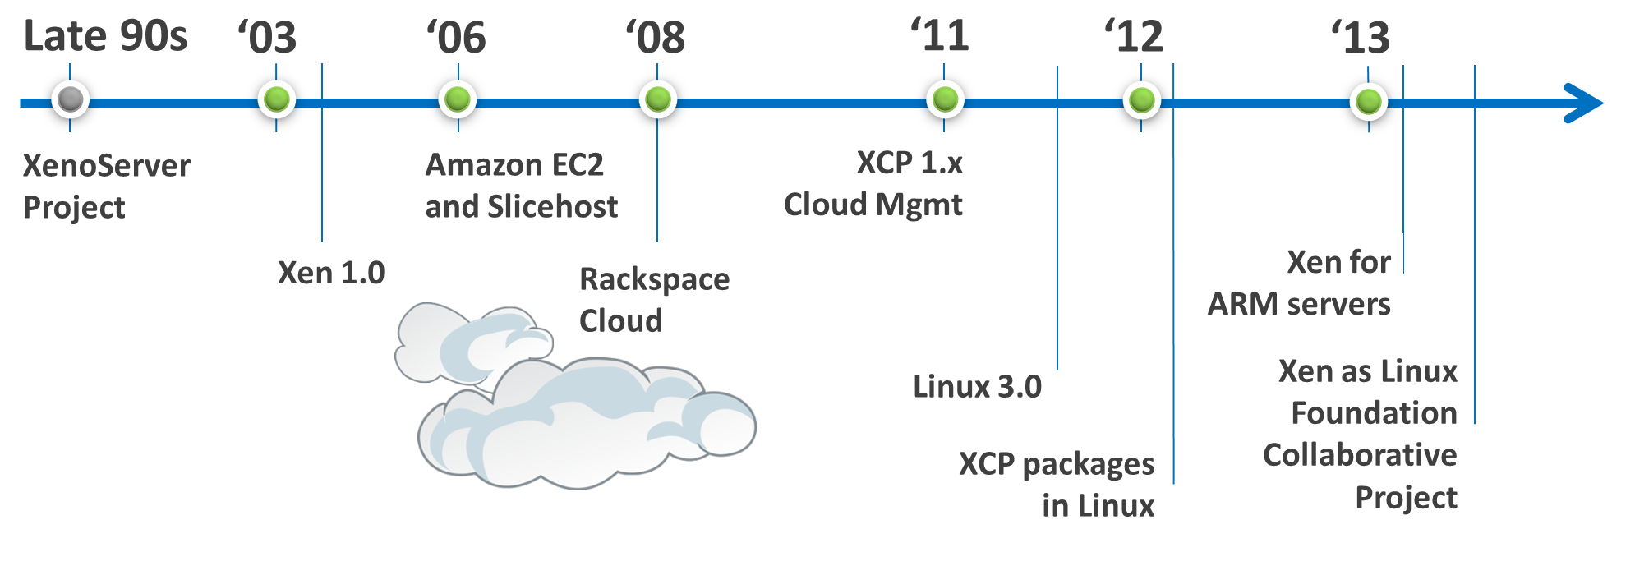
About Xen
Cambridge research project open sourced in 2002
2006 Microsoft and VMWare adopted Xen Paravirtualization concept
2007 Citrix acquired XenServer (proprietary system built by Xen lead researcher Ian Pratt)
2011 Linux 2.6.37 Xen 3.0 integrated upstream
Xen open source is managed by the Linux Foundation
http://www.xenproject.org/about/history.html

Slide 23
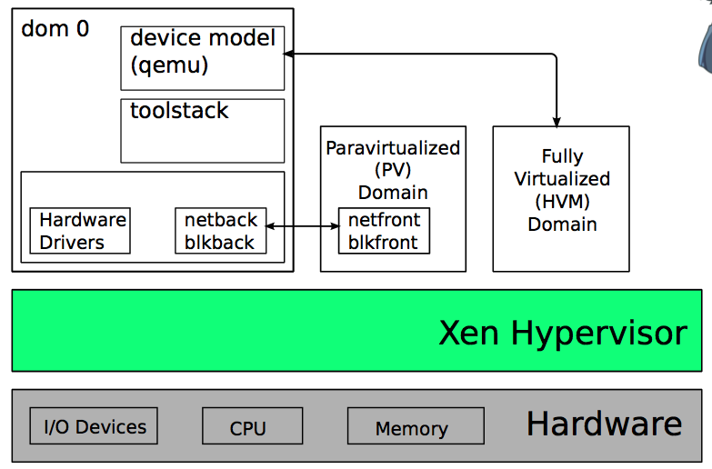
Xen Attributes
Xen is a thin hypervisor Operating System that sets up a privileged domain (Dom0) controls access to hardware
Linux Kernel includes features to detect if it is running on Xen
DomU can then run a host operating system like Linux
Paravirtualized guests run without hardware acceleration using modified operating systems
Fully-virtualized guests run with hardware acceleration using unmodified operating systems
Xen requires a special operating system implementation to run the hypervisor resulting in redundant code and driver support delays

Slide 24
Xen Attributes
Xen Hypervisor: <150,000 LOC manages CPU, memory, and interrupts
Guest Domains/VM’s: can run fully-virtualized (HVM) or para-virtualized
Control Domain (Dom0) specialized virtual machine that can access hardware directly and requires a Xen-project-enabled kernel

Slide 25
Xen security considerations
Access to Dom0 gives full visibility to hypervisor and all running VPM’s on system
Threats:
Attacker compromises network
Attacker compromises one guest OS (boot)
http://www.slideshare.net/xen_com_mgr/a-brief-tutorial-on-xens-advanced-security-features

Slide 26
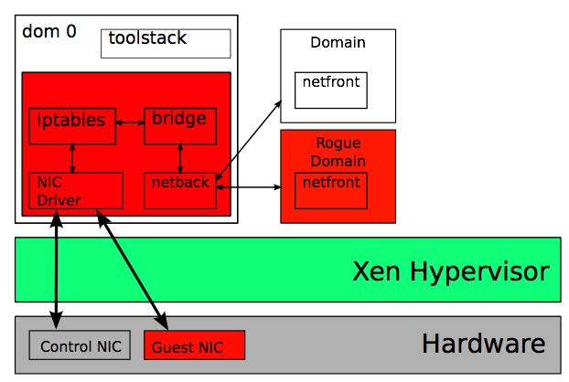
Xen: Attacker through network
Break in through hardware bugs, bugs in bridging / filtering or netback ring protocol
Full control of Dom0
Control of whole system

Slide 27
Xen Security Feature: Stub Domains
A small “service” domain running just one application
Useful for protecting secrets and high security applications from other domains
OS environment usually QEMU and MiniOS plus application
Small attack surface
Supports Full or Para-virtualization

Slide 28
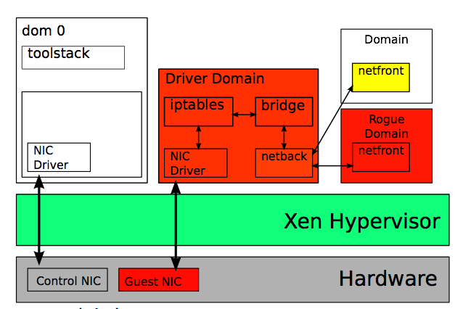
Xen: Mitigate attack through network
Employ Driver Domains
Restrict exploit to the driver domain and not Dom0
Opportunity to attack other guest netfront

Slide 29
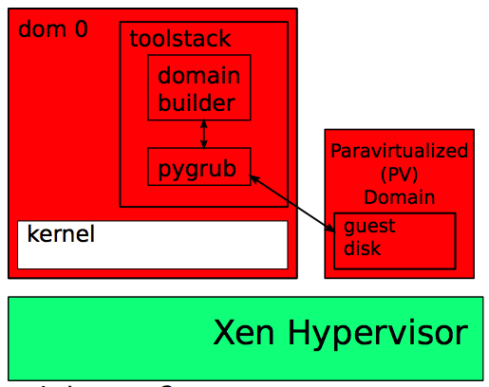
Xen: Attack boot (Pygrub)
Pygrub is grub for para-virtualized guests
Python program running in Dom0
Vulnerable from bugs in file system parser, menu parser, and domain builder
Attack gives full access to Dom0 and whole system

Slide 30
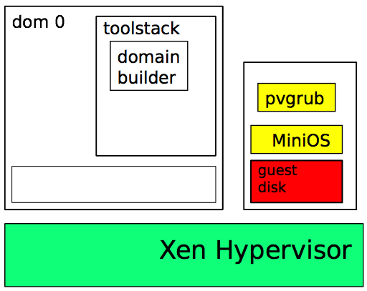
Xen Mitigate boot (Pygrub)
MiniOS + pv port of grub (pvgrub) running in a guest context
Para-virtualized equivalent of HVM “BIOS + grub”
Exploit can only compromise guest

Slide 31
Xen Security Feature: FLASK
What is FLASK?
Xen Security Model (Xen equivalent of LSM)
Framework for XSM developed by NSA
Xen Equivalent of SELinux (MAC)
What can FLASK do?
Restrict hypercalls to those needed by a guest
Allow fine-grained granting of privileges

Slide 32
Summary Best Practices
Pay particular attention to “trust boundaries” for vulnerabilities
Use the right virtualization/para-virtualization for the job at hand
LXC if security isn’t main goal but want to prevent containers from damaging host
KVM/XEN if you want to isolate guest OS and applications form the host and manage separately
Pick what is best balance for your resource and performance needs
Employ MAC to improve isolation and contain vulnerabilities

Slide 33
Introspection and Integrity
Using secure boot, most systems are able to verify integrity throughout the boot sequence:
CPU, ROM, Loader, OS
However, very little exists to monitor running systems after boot
Hypervisors give us an interesting opportunity to monitor applications

Slide 34
Virtualization and System Integrity
Great opportunity but still challenging

Slide 35
Measuring VMM and Guest Integrity
Most modern VMM’s leverage CPU virtualization extensions and DMA mapping to improve performance
This DMA mapping makes it more challenging to measure guest integrity (particularly for KVM/QEMU)
Maps are retained in CPU MMU
MMU maps with Second Level Address Translation (EPT/RVI/Stage-2)
How do you measure integrity of a virtual machine:
Stealthy: without giving attackers any indication you are taking measurements
Context-aware: while maintaining process context even with hardware-mapped virtualization

Slide 36
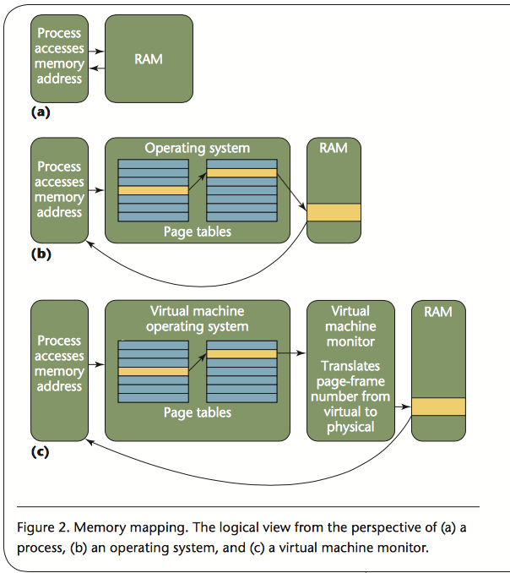
Memory Mapping
Virtualization adds a layer of complexity that makes introspection challenging

Slide 37
VMM-based Integrity Measurement Requirements
# | Title | Description
1 | Stealthy Invocation | Must be invoked without alerting or being visible to the measurement target
2 | Verifiable Behavior | The code-base of the measurement agent should be measured and verified before being invoked
3 | Deterministic Execution | After the measurement agent is invoked, it should be neither changeable nor interruptible (includes side-channel and cache-based attack resistance)
4 | In-context Privileged Measurement | The measurement agent should be privileged and in the right context to access the hypervisor code and data (Hypervisor context vs Guest context)
5 | Attestable Output | The measurement output needs to be securely conveyed to the remote verifier (e.g., TNC/TCG)
7 | Highest Privilege | Integrity management must operate at the highest privilege level in order to interpose on critical system operations.
8 | Isolate system control scripts | Containerize any SMM, BIOS, option ROM and power management scripts
9 | CPU Independent | Operates with similar capability no matter the CPU architecture (ARM/Intel)
10 | OS/VMM Independent | Operates with similar capability no matter the OS/VMM (Linux, Windows/ESXi,KVM)
11 | Active Monitoring | Refresh integrity measurement with new process creation or kernel changes
12 | Performance | Normal integrity checking operations should have minimal performance impact on the VMM or guest (< 10% overhead)

Slide 38
3 Questions
Q: Why does HyperSentry use SMM?
Q: What method does HyperSentry use to remain “Stealthy”?
Q: Name one limitation of KvmSec?
Notes:
Q: Why does HyperSentry use SMM?
A: Deterministic Execution: To protect integrity inspection code from attack
What method does HyperSentry use to remain “Stealthy”?
A: Stealthy: IPMI
Q: Name one limitation of KvmSec?
Answer possibilities:
Not Stealthy: Installs kernel modules and character device in guest so is visible to attackers
No Attestable Output: Shared memory communication channel to host from guest is vulnerable
Not CPU Independent: Supports only Intel processors
Not OS/VMM Independent: Doesn’t work with Windows guests

Slide 39
Thank You – Questions?

Slide 40
References
Unprivileged Containers: https://www.stgraber.org/2014/01/17/lxc-1-0-unprivileged-containers/
LXC Dockers and Security: http://www.slideshare.net/jpetazzo/linux-containers-lxc-docker-and-security
Linux advanced routing and and Traffic Control: http://www.lartc.org/howto/
Guestfish: http://libguestfs.org/

